Slide 1




Sports Basics
Special Edition Magazine on (IPL) 2024 Presentation
Presented By : Vineet Patyal
Codebasics Resume Project Challenge #10

Slide 2









CONTENT
Problem Statement
Introduction
Objective
Soft Tools
ERD Diagram
Primary Insights
Predictions
Conclusion

Slide 3
Problem Statement and Company Overview
"Sports Basics" is a sports blog company that entered space recently. They wanted to get more traffic to their website by releasing a special edition magazine on IPL 2024. This magazine aims to provide interesting insights and facts for fans, analysts and teams based on the last 3 years' data. The chief editor Tony Sharma oversees this publication, and he believes in data analytics. He reached out to Peter Pandey, a journalist in his team who is a data savvy cricket enthusiast.

Slide 4

Introduction
The 17th IPL season (IPL 2024) runs from March 22nd to May 26th. Ten teams battle it out in Twenty20 matches across India. Chennai Super Kings are the defending champions. Playoffs begin May 21st with the final in Chennai on May 26th.

Slide 5










Team Playing
Chennai Super Kings
Gujarat Titans
Delhi Capitals
Sunrisers Hyderabad
Lucknow Super Giants
Punjab Kings
Mumbai Indians
Rajasthan Royals
Sunrisers Hyderabad
Royal Challengers Bengaluru

Slide 6
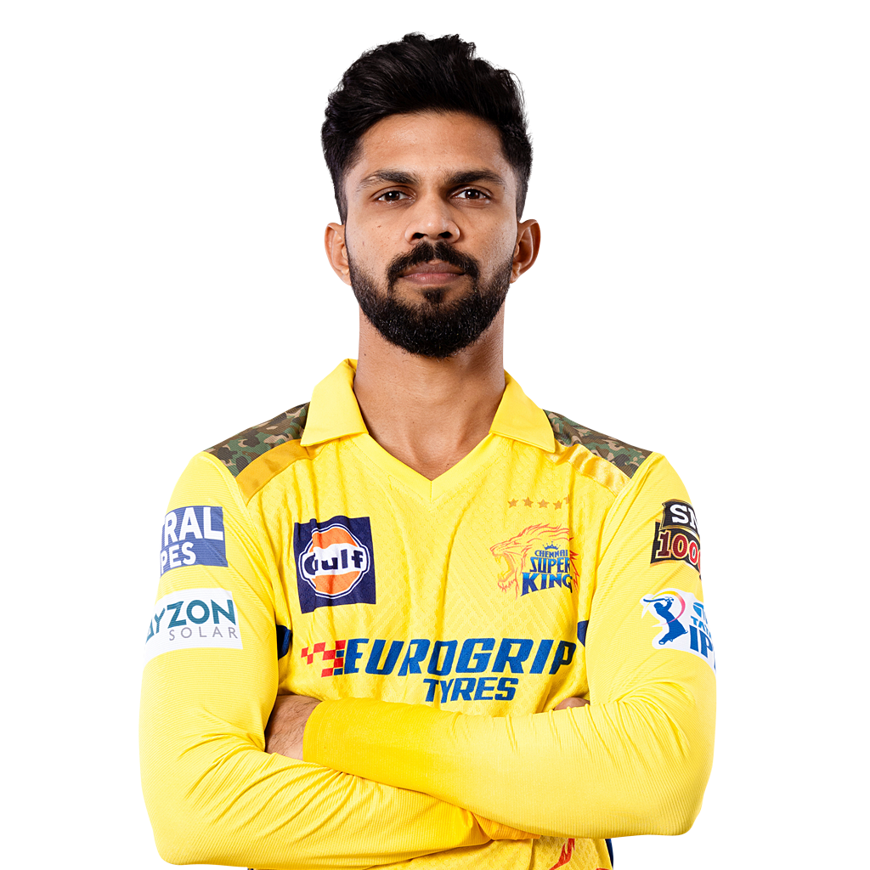


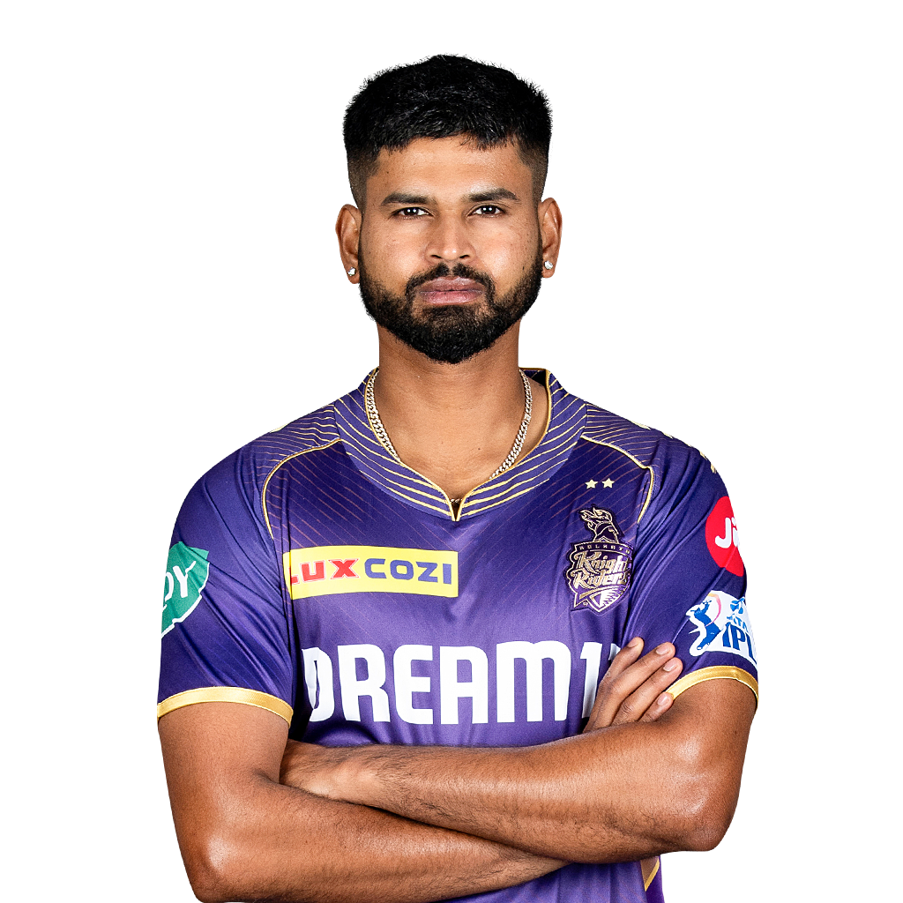
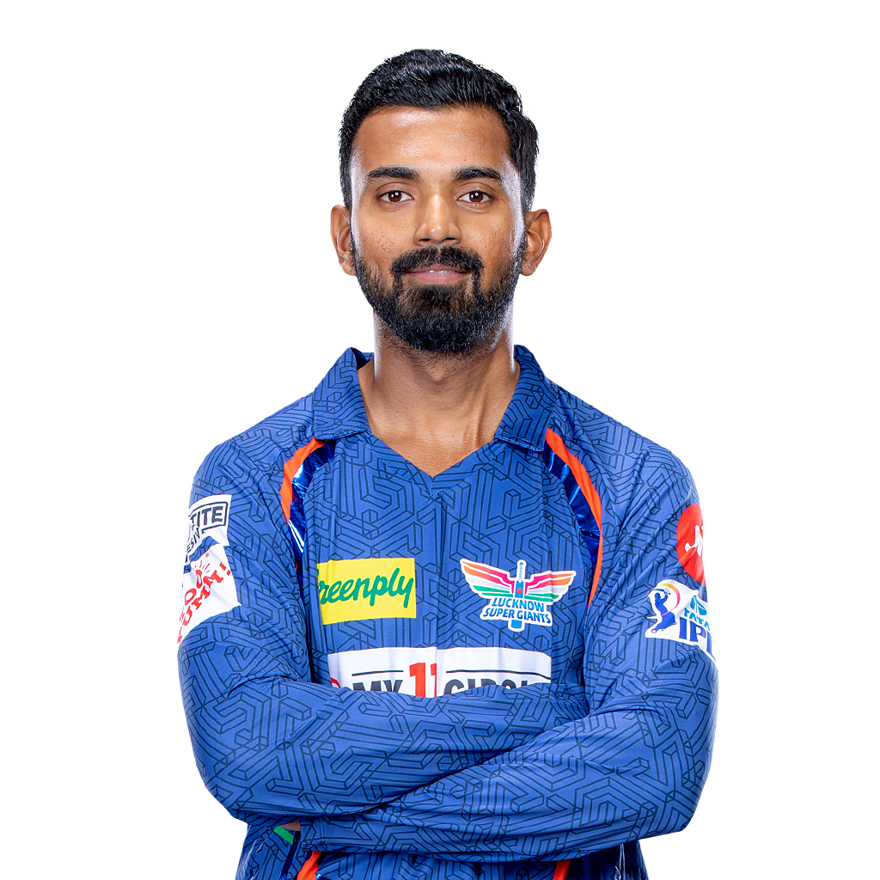

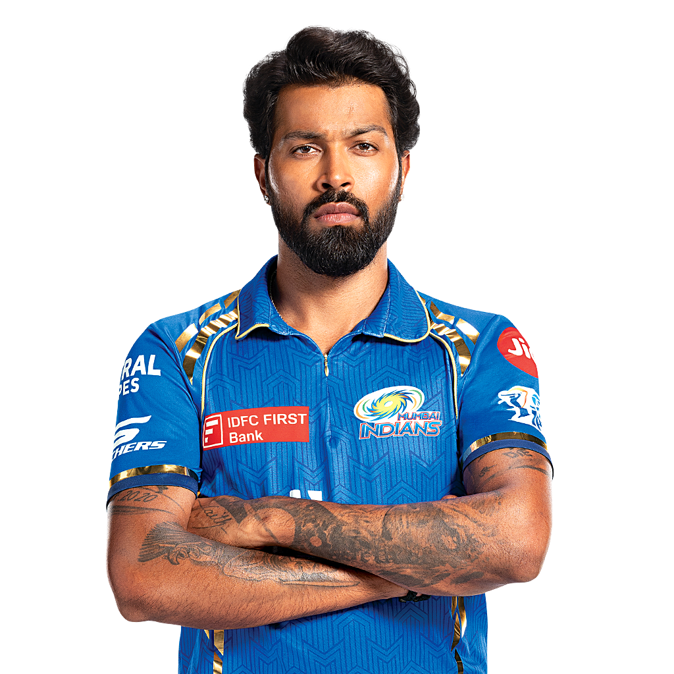
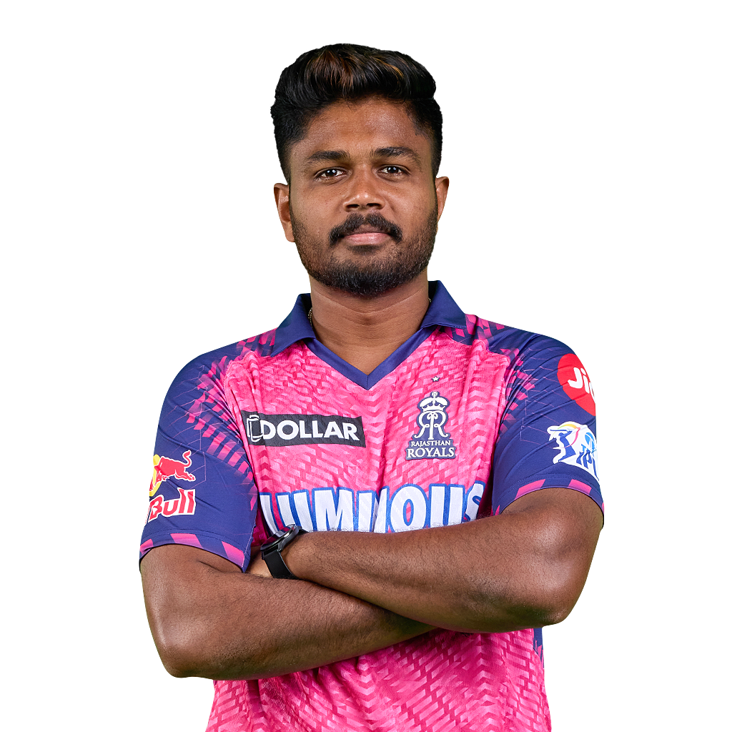


Team Captions
Ruturaj Gaikwad
Shubman Gill
Rishabh Pant
Shreyas Iyer
KL Rahul
Shikhar Dhawan
Hardik Pandya
Sanju Samson
Pat Cummins
Faf du Plessis

Slide 7
OBJECTIVE
Increase traffic to the Sports Basics website through a special edition magazine focusing on IPL 2024.
Objective is to provide insights and facts for fans, analysts, and teams based on data analytics of the last 3 years' IPL matches.
Utilize data analytics to extract meaningful insights and trends from the IPL match data spanning the past three years.
Utilizing soft tools such as Excel & Power Query For Data Transformation, Power BI for Visuals , SQL for Primary Insights & Power point for presentation.
Using 3 years provided data for Predictions.
Providing valuable primary Insights such as:
1. Top 10 batsmen based on past 3 years total runs scored.
2. Top 10 batsmen based on past 3 years batting average. (min 60 balls faced in each season)
3. Top 10 batsmen based on past 3 years strike rate (min 60 balls faced in each season)
4. Top 10 bowlers based on past 3 years total wickets taken.
5. Top 10 bowlers based on past 3 years bowling average. (min 60 balls bowled in each season)
6. Top 10 bowlers based on past 3 years economy rate. (min 60 balls bowled in each season)
7. Top 5 batsmen based on past 3 years boundary % (fours and sixes).
8. Top 5 bowlers based on past 3 years dot ball %.
9. Top 4 teams based on past 3 years winning %.
10.Top 2 teams with the highest number of wins achieved by chasing targets over the past 3 years.

Slide 8




TOOLS USED
EXCEL and Power Query used for Data Cleaning and Data Transformation
Power BI is used for visuals and various predictions mentioned in the presentation
MySQL language is used to derive primary Insights
Power Point is used for visual presentation

Slide 9
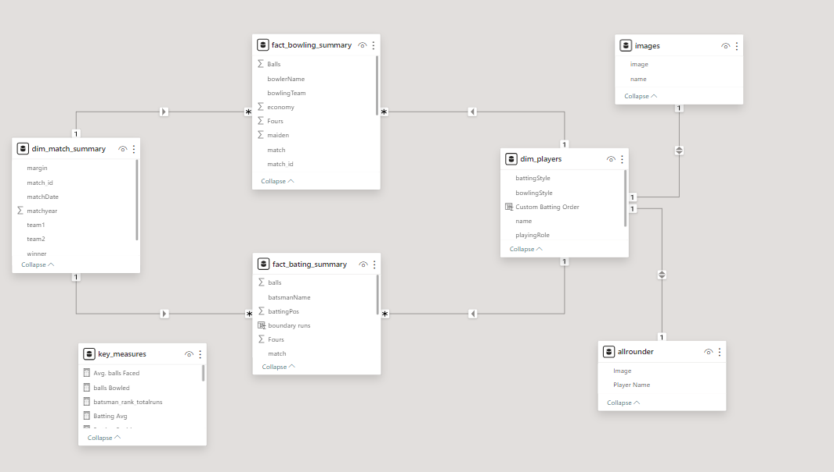
ENTITY RELATIONSHIP DIAGRAM

Slide 10
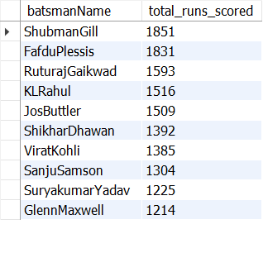
PRIMARY INSIGHTS
1. Top 10 batsmen based on past 3 years total runs scored.
SQL Query
OUTPUT
SELECT
batsmanName,
sum(runs) as total_runs_scored
FROM ipl_2024.fact_bating_summary
group by
batsmanName
order by
total_runs_scored desc
limit 10;

Slide 11
Top 10 batsmen based on past 3 years total runs scored.
VISUALS

Slide 12
2. Top 10 batsmen based on past 3 years batting average. (min 60 balls faced in each season)
SQL Query
Yearly_stats
CTE1
overall_stats
CTE4
WITH yearly_stats AS (
SELECT
fs.batsmanName, dm.matchyear,
SUM(fs.runs) AS total_runs,
SUM(fs.balls) AS total_balls
FROM
fact_bating_summary fs JOIN dim_match_summary dm ON
fs.match_id = dm.match_id
WHERE
dm.matchyear BETWEEN 2021 AND 2023
GROUP BY
fs.batsmanName, dm.matchyear
),
yearly_ball_counts AS (
SELECT batsmanName,
SUM(CASE WHEN matchyear = 2021 THEN total_balls END) AS balls_2021,
SUM(CASE WHEN matchyear = 2022 THEN total_balls END) AS balls_2022,
SUM(CASE WHEN matchyear = 2023 THEN total_balls END) AS balls_2023
FROM
yearly_stats
GROUP BY
batsmanName
),
qualified_batsmen AS (
SELECT batsmanName
FROM yearly_ball_counts
WHERE
balls_2021 >= 60 AND balls_2022 >= 60 AND balls_2023 >= 60
),
overall_stats AS (
SELECT fs.batsmanName,
SUM(fs.runs) AS overall_runs,
SUM(fs.out) AS overall_outs
FROM fact_bating_summary fs
JOIN dim_match_summary dm ON fs.match_id = dm.match_id WHERE
dm.matchyear BETWEEN 2021 AND 2023 AND fs.batsmanName IN (SELECT batsmanName FROM qualified_batsmen)
GROUP BY
fs.batsmanName
),
final_stats AS (
SELECT
os.batsmanName, os.overall_runs, os.overall_outs, round((os.overall_runs / os.overall_outs),2) AS batting_average FROM
overall_stats os
)
SELECT
batsmanName,
overall_runs,
overall_outs,
batting_average
FROM
final_stats
ORDER BY batting_average DESCLIMIT 10;
Common Table Expressions ( CTE )
Yearly_ball_counts
CTE2
final_stats
CTE5
qualified_batsmen
CTE3

Slide 13
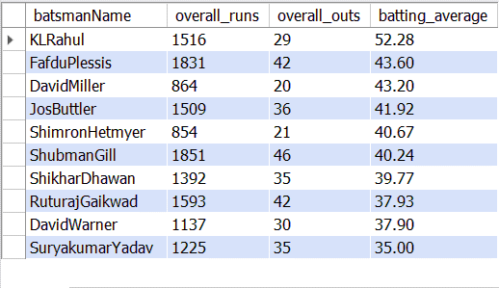
VISUAL OUTPUT

Slide 14
3. Top 10 batsmen based on past 3 years strike rate (min 60 balls faced in each season)
SQL Query
Yearly_stats
CTE1
overall_stats
CTE4
WITH yearly_stats AS (
SELECT
fs.batsmanName, dm.matchyear,
SUM(fs.runs) AS total_runs,
SUM(fs.balls) AS total_balls
FROM
fact_bating_summary fs JOIN dim_match_summary dm
ON fs.match_id = dm.match_id
WHERE
dm.matchyear BETWEEN 2021 AND 2023
GROUP BY
fs.batsmanName,
dm.matchyear
),
yearly_ball_counts AS (
SELECT batsmanName,
SUM(CASE WHEN matchyear = 2021 THEN total_balls END) AS balls_2021,
SUM(CASE WHEN matchyear = 2022 THEN total_balls END) AS balls_2022,
SUM(CASE WHEN matchyear = 2023 THEN total_balls END) AS balls_2023
FROM
yearly_stats
GROUP BY
batsmanName
),
qualified_batsmen AS (
SELECT batsmanName
FROM yearly_ball_counts
WHERE
balls_2021 >= 60 AND balls_2022 >= 60 AND balls_2023 >= 60
),
overall_stats AS (
SELECT
fs.batsmanName,
SUM(fs.runs) AS overall_runs,
SUM(fs.balls) AS overall_balls
FROM
fact_bating_summary fs
JOIN dim_match_summary dm ON fs.match_id = dm.match_id
WHERE
dm.matchyear BETWEEN 2021 AND 2023
AND fs.batsmanName IN (SELECT batsmanName FROM qualified_batsmen)
GROUP BY
fs.batsmanName
),
final_stats AS (
SELECT
os.batsmanName, os.overall_runs, os.overall_balls,
round((os.overall_runs / os.overall_balls) * 100,2) AS strike_rate
FROM
overall_stats os
)
SELECT
batsmanName, overall_runs,
overall_balls, strike_rate
FROM
final_stats
ORDER BY
strike_rate DESC
LIMIT 10;
Common Table Expressions ( CTE )
Yearly_ball_counts
CTE2
final_stats
CTE5
qualified_batsmen
CTE3

Slide 15
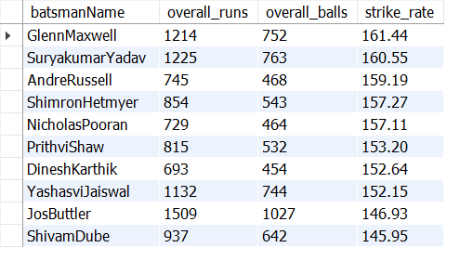
VISUAL OUTPUT

Slide 16
4. Top 10 bowlers based on past 3 years total wickets taken.
SQL Query
Visual Output
Select
bowlername,
SUM(wickets) as total_wickets
from
fact_bowling_summary
group by
bowlerName
order by
total_wickets
desc
Limit 10;

Slide 17
5. Top 10 bowlers based on past 3 years bowling average. (min 60 balls bowled in each season)
SQL Query
Yearly_stats
CTE1
overall_stats
CTE4
WITH yearly_stats AS (
SELECT
fbs.bowlerName, dm.matchyear,
SUM(fbs.runs) AS total_runs_conceded, SUM(fbs.balls) AS total_balls_bowled
FROM
fact_bowling_summary fbs
JOIN
dim_match_summary dm ON fbs.match_id = dm.match_id
WHERE
dm.matchyear BETWEEN 2021 AND 2023
GROUP BY
fbs.bowlerName, dm.matchyear
),
yearly_balls_bowled AS (
SELECT
bowlerName,
SUM(CASE WHEN matchyear = 2021 THEN total_balls_bowled END) AS balls_bowled_2021,
SUM(CASE WHEN matchyear = 2022 THEN total_balls_bowled END) AS balls_bowled_2022,
SUM(CASE WHEN matchyear = 2023 THEN total_balls_bowled END) AS balls_bowled_2023
FROM
yearly_stats
GROUP BY
bowlerName
),
qualified_bowlers AS (
SELECT bowlerName
FROM yearly_balls_bowled
WHERE
balls_bowled_2021 >= 60 AND balls_bowled_2022 >= 60 AND balls_bowled_2023 >= 60
),
overall_stats AS (
SELECT
fbs.bowlerName,
SUM(fbs.runs) AS overall_runs_conceded,
SUM(fbs.wickets) AS overall_wickets_taken
FROM
fact_bowling_summary fbs
JOIN
dim_match_summary dm ON fbs.match_id = dm.match_id
WHERE
dm.matchyear BETWEEN 2021 AND 2023
AND fbs.bowlerName IN (SELECT bowlerName
FROM qualified_bowlers)
GROUP BY fbs.bowlerName
),
final_stats AS (
SELECT
os.bowlerName, os.overall_runs_conceded, os.overall_wickets_taken,
round(SUM(os.overall_runs_conceded)/
SUM(os.overall_wickets_taken),2) AS bowling_avg
FROM
overall_stats os
group by
os.bowlerName
)
SELECT
bowlerName, overall_runs_conceded,
overall_wickets_taken, bowling_avg
FROM final_stats
ORDER BY bowling_avg ASC
LIMIT 10;
Common Table Expressions ( CTE )
Yearly_balls_bowled
CTE2
final_stats
CTE5
qualified_bowlers
CTE3

Slide 18
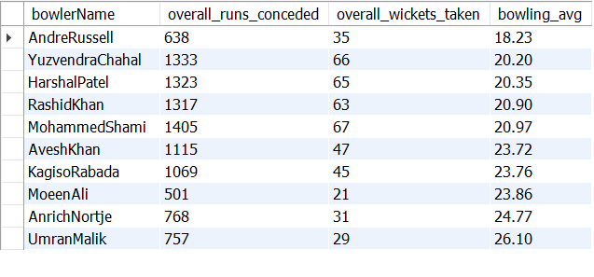
VISUAL OUTPUT

Slide 19
6. Top 10 bowlers based on past 3 years economy rate. (min 60 balls bowled in each season)
SQL Query
Yearly_stats
CTE1
overall_stats
CTE4
WITH yearly_stats AS (
SELECT
fbs.bowlerName, dm.matchyear,
SUM(fbs.runs) AS total_runs_conceded, SUM(fbs.balls) AS total_balls_bowled
FROM
fact_bowling_summary fbs
JOIN
dim_match_summary dm ON fbs.match_id = dm.match_id
WHERE
dm.matchyear BETWEEN 2021 AND 2023
GROUP BY
fbs.bowlerName, dm.matchyear
),
yearly_balls_bowled AS (
SELECT
bowlerName,
SUM(CASE WHEN matchyear = 2021 THEN total_balls_bowled END) AS balls_bowled_2021,
SUM(CASE WHEN matchyear = 2022 THEN total_balls_bowled END) AS balls_bowled_2022,
SUM(CASE WHEN matchyear = 2023 THEN total_balls_bowled END) AS balls_bowled_2023
FROM
yearly_stats
GROUP BY
bowlerName
),
qualified_bowlers AS (
SELECT bowlerName
FROM
yearly_balls_bowled
WHERE
balls_bowled_2021 >= 60 AND balls_bowled_2022 >= 60 AND balls_bowled_2023 >= 60
),
overall_stats AS (
SELECT
fbs.bowlerName, SUM(fbs.runs) AS overall_runs_conceded,
SUM(fbs.balls) AS overall_balls_bowled
FROM
fact_bowling_summary fbs
JOIN
dim_match_summary dm ON fbs.match_id = dm.match_id
WHERE
dm.matchyear BETWEEN 2021 AND 2023
AND fbs.bowlerName IN (SELECT bowlerName FROM qualified_bowlers)
GROUP BY
fbs.bowlerName
),
final_stats AS (
SELECT
os.bowlerName, os.overall_runs_conceded, os.overall_balls_bowled,
round(SUM(os.overall_runs_conceded)/
SUM(os.overall_balls_bowled/6),2) AS economy_rate
FROM overall_stats os
Group by os.bowlerName
)
SELECT
bowlerName, overall_runs_conceded, overall_balls_bowled,
round(SUM(os.overall_runs_conceded) /SUM(overall_balls_bowled/6)) as overs_bowled, economy_rate
FROM
final_stats
Group by bowlerName
ORDER BY economy_rate ASC
LIMIT 10;
Common Table Expressions ( CTE )
Yearly_balls_bowled
CTE2
final_stats
CTE5
qualified_bowlers
CTE3

Slide 20
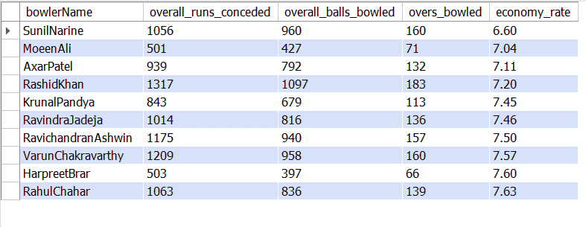
Visual Outputs

Slide 21
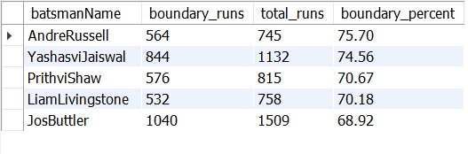
7. Top 5 batsmen based on past 3 years boundary % (fours and sixes).
SQL Query
boundary_stats
CTE1
WITH boundary_stats AS (
SELECT
fbs.batsmanName,
SUM(fbs.Fours * 4 + fbs.Sixes * 6) AS boundary_runs, -- Total boundary runs
SUM(fbs.runs) AS total_runs -- Total runs scored
FROM
fact_bating_summary fbs
INNER JOIN
dim_match_summary dms ON fbs.match_id = dms.match_id
WHERE
dms.matchyear BETWEEN YEAR(CURDATE()) - 3 AND YEAR(CURDATE()) - 1
GROUP BY
fbs.batsmanName
),
boundary_percentage AS (
SELECT
batsmanName,
boundary_runs,
total_runs,
round((sum(boundary_runs) / sum(total_runs) * 100),2) AS boundary_percent -- Calculating boundary percentage
FROM
boundary_stats
WHERE
total_runs > 500
Group by
batsmanName
)
SELECT
batsmanName,
boundary_runs,
total_runs,
boundary_percent
FROM
boundary_percentage
ORDER BY
boundary_percent DESC
LIMIT 5;
Boundary_percentage
CTE2
Query Output

Slide 22
Visual Output

Slide 23
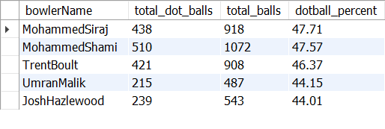
8. Top 5 bowlers based on past 3 years dot ball %.
SQL Query
Yearly_performance
CTE1
dot_ball_percentage
CTE2
WITH yearly_performance AS (
SELECT
dms.matchyear,fbs.bowlerName,
SUM(fbs.Zeros) AS total_dot_balls, SUM(fbs.balls) AS total_balls
FROM
fact_bowling_summary fbs
JOIN dim_match_summary dms ON fbs.match_id = dms.match_id
WHERE
dms.matchyear IN (2021, 2022, 2023)
GROUP BY
dms.matchyear, fbs.bowlerName
),
bowlers_active_all_years AS (
SELECT
bowlerName
FROM
yearly_performance
GROUP BY bowlerName
HAVING
COUNT(DISTINCT matchyear) = 3
),
overall_performance AS (
SELECT
yp.bowlerName, SUM(yp.total_dot_balls) AS total_dot_balls,
SUM(yp.total_balls) AS total_balls
FROM
yearly_performance yp
WHERE
yp.bowlerName IN (SELECT bowlerName FROM bowlers_active_all_years)
GROUP BY yp.bowlerName
),
dot_ball_percentage AS (
SELECT
op.bowlerName, op.total_dot_balls, op.total_balls,
round((op.total_dot_balls / op.total_balls)* 100,2) AS dotball_percent
FROM
overall_performance op
)
SELECT
dbp.bowlerName, dbp.total_dot_balls,
dbp.total_balls, dbp.dotball_percent
FROM
dot_ball_percentage dbp
ORDER BY
dbp.dotball_percent DESC
LIMIT 5;
Bowlers_active_all_years
CTE2
Query Output
Overall_performance
CTE2

Slide 24
Visual Output

Slide 25
9. Top 4 teams based on past 3 years winning %.
SQL Query
team_wins ( total wins obtained by teams in both team1 & team2 category )
CTE1
WITH team_wins AS (
SELECT
team1 AS team, matchyear,
COUNT(*) AS wins
FROM
dim_match_summary
WHERE
winner = team1
AND matchyear BETWEEN 2021 AND 2023
GROUP BY
team1, matchyear
UNION ALL
SELECT
team2 AS team, matchyear,
COUNT(*) AS wins
FROM
dim_match_summary
WHERE
winner = team2
AND matchyear BETWEEN 2021 AND 2023
GROUP BY
team2, matchyear
),
team_matches AS (
SELECT
team1 AS team,
matchyear,
COUNT(*) AS matches
FROM
dim_match_summary
WHERE
matchyear BETWEEN 2021 AND 2023
GROUP BY
team1, matchyear
UNION ALL
SELECT
team2 AS team, matchyear,
COUNT(*) AS matches
FROM
dim_match_summary
WHERE
matchyear BETWEEN 2021 AND 2023
GROUP BY
team2, matchyear
)
SELECT
tw.team,
SUM(tw.wins) AS total_wins,
SUM(tm.matches) AS total_matches,
round((SUM(tw.wins) / SUM(tm.matches)) * 100, 2) AS winning_percentage
FROM
team_wins tw
JOIN
team_matches tm ON tw.team = tm.team AND tw.matchyear = tm.matchyear
GROUP BY
tw.team
ORDER BY
winning_percentage DESC
LIMIT 4;
Merge between Team1 & Team2 for total matches played by all teams
UNION ALL
Merge between Team1 & Team2 for total wins of all teams
UNION ALL
team_matches ( total matches played by teams in team1 & team2 category )
CTE2

Slide 26

Top 4 Qualifying Teams
Winning percentage over the last 3 years of IPL seasons :
Gujarat Titans (69.7%), Lucknow Super Giants (58.62%),
Royal Challengers Bangalore (55.56%), and Chennai Super Kings (55.56%).

Slide 27
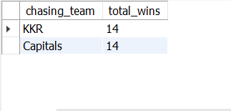
10. Top 2 teams with the highest number of wins achieved by chasing targets over the past 3 years.
SQL Query
Chasing_wins
CTE
With chasing_wins as (
Select
team2 as chasing_team,
matchyear,
count(*) as wins
from
dim_match_summary
Where
winner = team2 and
matchyear between 2021 and 2023
group by
team2, matchyear
)
select
cw.chasing_team,
sum(cw.wins) as total_wins
from
chasing_wins cw
group by
cw.chasing_team
order by
total_wins desc
limit 2;
Query Output

Slide 28

Top 2 Teams with Highest wins in past 3 years
Kolkata Knight Riders and Delhi Capitals both achieved the highest number of victories, totalling 14 wins each.

Slide 29


ORANGE CAP PREDICTION
Overall Performance
Name
VIRAT KOHLI
-
-
Team
ROYAL CHALLENGERS BENGLURU
Total runs
-
1385
Innings
-
45
Strike Rate
-
127.06
Batting Avg
-
33.78
Boundary%
-
54.73%
2021
2022
2023
Total runs
-
405
Total runs
-
341
Total runs
-
639
Batting Avg
-
28.93
Batting Avg
-
22.73
Batting Avg
-
53.25
Innings
-
15
RANK 11
Innings
-
16
RANK 22
Innings
-
14
RANK 4
Strike Rate
-
119.47
Strike Rate
-
115.99
Strike Rate
-
139.82
Boundary%
-
55.80%
Boundary%
-
51.61%
Boundary%
-
55.71%

Slide 30

PURPLE CAP PREDICTION
Overall Performance
Name
YUZVENDRA CHAHAL
-
-
Team
RAJATHAN ROYALS
Total Wickets
-
66
Innings
-
46
Strike Rate
-
15.80
Bowling Eco
-
7.67
Dot Ball %
-
34.61%
2021
2022
2023
Total Wickets
-
-
18
Total Wickets
27
-
Total Wickets
21
Bowling Eco
-
7.06
Bowling Eco
-
7.75
Bowling Eco
-
8.18
Innings
-
18
RANK 4
Innings
-
17
RANK 1
Innings
-
14
RANK 4
Strike Rate
-
17.67
Strike Rate
-
15.11
Strike Rate
-
15.10
Dot Ball %
-
39.94%
Dot Ball %
-
33.58%
Dot Ball %
-
30.60%

Slide 31
Top 4 Qualifying Teams
Prediction of Top 4 Qualifying teams based on winning percentage over the last 3 years of IPL seasons : Gujarat Titans (69.7%), Lucknow Super Giants (58.62%), Royal Challengers Bangalore (55.56%), and Chennai Super Kings (55.56%).

Slide 32
?
Winner and Runner up?

Slide 33


Winner
Runner up
Consistent Performances: Lucknow Super Giants is known for it’s consistent performances in previous season, with key players delivering consistently strong performances in both batting and bowling departments.
Balanced Squad: Lucknow Super Giants might have had a well-balanced squad comprising both experienced players and emerging talents.
As a captain KL Rahul is really good at staying cool and making smart choices during tough moments in games. This can help the team stay focused and play better when things get intense.

Slide 34
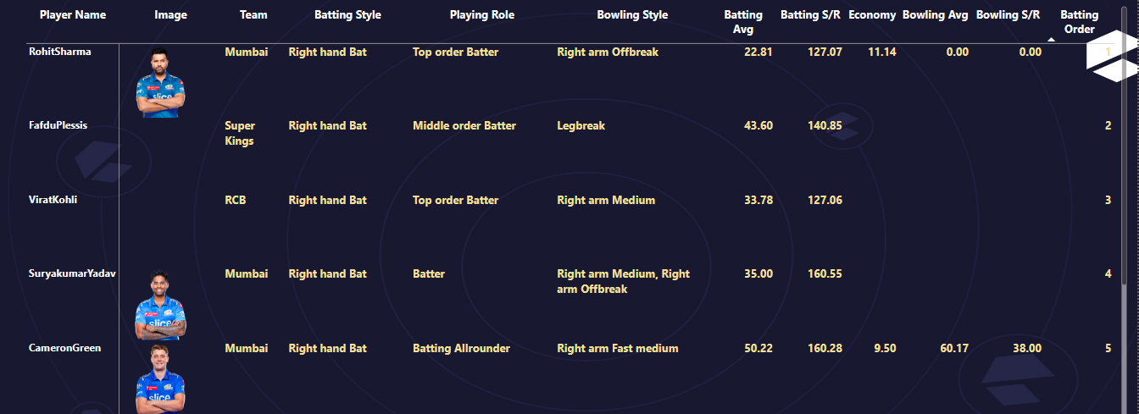

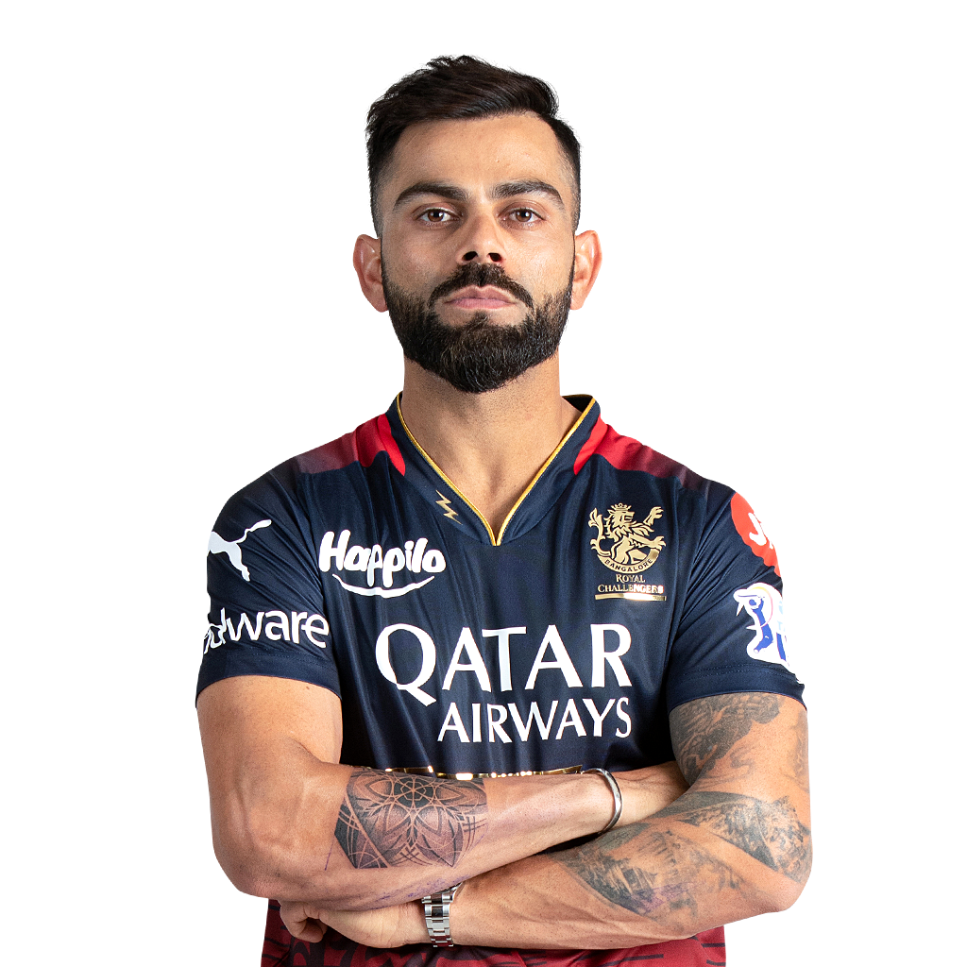
BEST 11

Slide 35
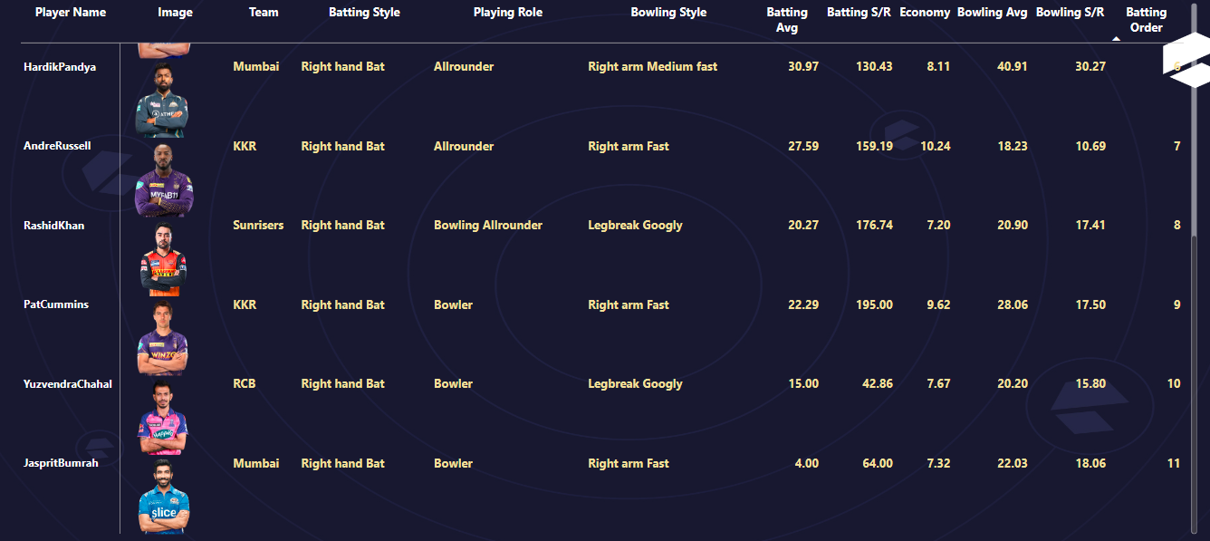
BEST 11

Slide 36
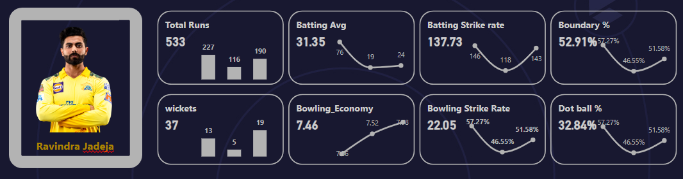
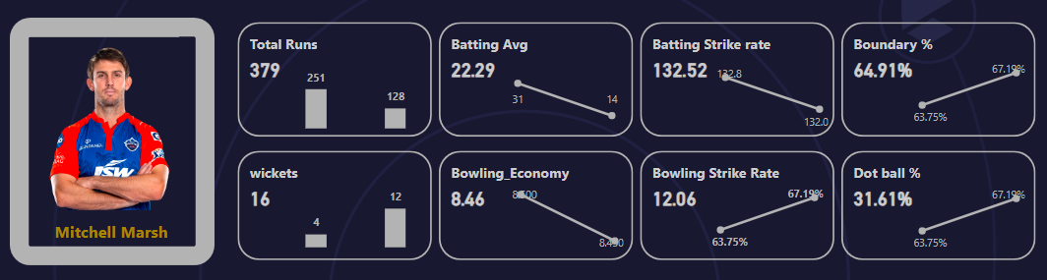
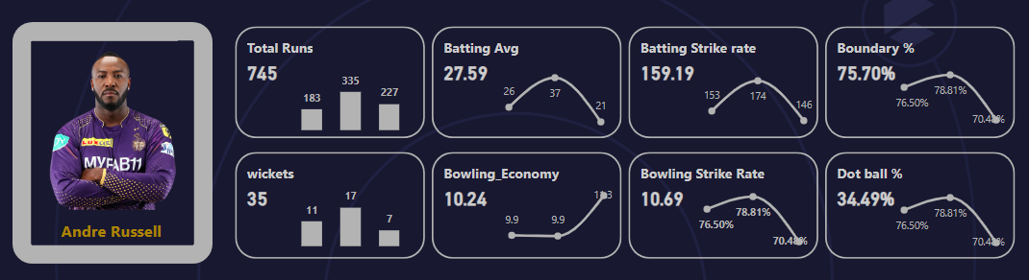
TOP 3 ALL ROUNDERS

Slide 37

Conclusion
In conclusion, IPL is a huge hit among cricket fans. At the end of this, we will see which team will win the trophy in the final match. So keep watching and keep supporting your Team.

Slide 38




Thank You!

